Slide 1

IT-4259: Computer Network Security
for
4th Year 2nd Semester of B.Sc (Honors) in IT (5th Batch)
Lecture: 13
RSA and Other Cryptosystems
Prepared by:
K M Akkas Ali
akkas_khan@yahoo.com, akkas@juniv.edu
Associate Professor
Institute of Information Technology (IIT)
Jahangirnagar University, Dhaka-1342

Slide 2
Lecture-13: RSA and Other Cryptosystems
Objectives of this Lecture:
  To discuss the RSA cryptosystem
  To discuss the Rabin cryptosystem
  To discuss the ElGamal cryptosystem
13.<number>

Slide 3
RSA Cryptosystem
  RSA is the most commonly used public-key cryptography algorithm, which uses prime factorization as the trapdoor one-way function. That is, it is based on the presumed difficulty of factoring large integers.
  It is named so after the surnames of its inventors Ron Rivest, Adi Shamir, and Leonard Adleman of the Massachusetts Institute of Technology (MIT).
  It was first published in 1978.
  This algorithm relies on one way function. A one way function is easy to compute but hard to invert. For example it is easy to take the product of two prime numbers but given the product, it is difficult to split it into the original prime factors.
  This algorithm lets you choose the size of your public key.
  The 512-bit keys are considered insecure or weak, but the 768-bit keys are secure from everything but the National Security Administration (NSA).
  The 1024-bit keys are secure from everything virtually.
  RSA is embedded in major products such as Windows, Netscape Navigator etc.
13.3

Slide 4
How the RSA Cryptosystem Works?
  Briefly, the RSA algorithm involves multiplying two large prime numbers and through additional operations deriving a set of two numbers e and d where e is the public key and d is the private key.
  Once the keys have been developed, the original prime numbers are no longer important and can be discarded. Both the public and the private keys are needed for encryption /decryption but only the owner of a private key ever needs to know it. Using the RSA system, the private key never needs to be sent across the Internet.
  Anyone can use the public key to encrypt a message. But the message can be decrypted only by the owner of the private key.
  Thus, if Alice wants to send a message to Bob, she can find out Bob’s public key (but not his private key) from a central administrator.
  After getting the public key of Bob, Alice then encrypt the message using Bob’s public key and sends the encrypted message to Bob.
  When Bob receives it, he decrypts it with his private key.
  In addition to encrypting messages (which ensures privacy), Bob can authenticate himself to Alice (so Alice knows that it is really Bob who sent the message) by using Bob’s private key to encrypt a digital certificate. When Alice receives it, she can use Bob’s public key to decrypt it.
13.4

Slide 5
Steps in RSA Algorithm
  The RSA algorithm involves three steps:
  Key generation (Generating public and private key)
  Encryption (Encrypting the message)
  Decryption (Decrypting the message)
  RSA involves a public key and a private key.
  The public key can be known by everyone and is used for encrypting messages.
  Messages encrypted with the public key can only be decrypted in a reasonable amount of time using the private key.
13.5

Slide 6
RSA Algorithm: Key Generation
  The keys for the RSA algorithm are generated by the following ways:
Choose two large and distinct prime numbers p and q.
  For security purposes, the integers p and q should be chosen at random, and should be of similar bit-length.
  In RSA, p and q must be at least 512 bits; n must be at least 1024 bits.
  Prime integers can be efficiently found using a primality test.
Compute n = p * q
  n is used as the modulus for both the public and private keys. Its length, usually expressed in bits, is the key length.
Compute the number of integers less than n that are coprime with n (otherwise known as the totient or Euler’s Phi function):
  φ(n) = φ(p*q) = φ(p)* φ(q)=(p - 1) * (q – 1)
Choose an integer e such that 1 < e < φ(n) and gcd(e, φ(n)) = 1; i.e. e and φ(n) are coprime.
  e is released as the public key exponent (encryption exponent).
  e having a short bit-length results in more efficient encryption– most commonly 2¹⁶ + 1 = 65,537. However, much smaller values of e (such as 3) have been shown to be less secure in some settings.
13.6

Slide 7
RSA Algorithm: Key Generation
  Determine the multiplicative inverse d of e; i.e., compute a value for d such that it satisfies the relation: (d * e) mod φ(n) = 1
  d is kept as the private key exponent (decryption exponent).
  d is often computed using the extended Euclidean algorithm.
  d must be kept secret.
  p, q, and φ(n) must also be kept secret because they can be used to calculate d.
The public key consists of the modulus n and the public key exponent e; i.e., the public key is (e, n).
The private key consists of the modulus n and the private key exponent d; i.e., the private key is (d, n).
To encrypt message m using the public key, use the relation:
c = m^{e} mod n
To decrypt c using the private key, use the relation:
m = c^{d} mod n
13.7

Slide 8
RSA Algorithm: Encryption
  Bob transmits his public key (e, n) to Alice and keeps the private key (d, n) secret.
  Alice then wishes to send message M to Bob.
  The message is encrypted by the following ways:
  Alice first turns message M into an integer m, such that 0 ≤ m < n.
  That is, the message is represented as an integer between 0 and (n-1).
  Large messages can be broken up into a number of blocks. Each block would then be represented by an integer in the same range.
  After turning the message into integer, Alice then computes the ciphertext c using the following relation:
  c = m^{e} mod n
  After computing ciphertext, Alice then transmits c to Bob.
13.8

Slide 9
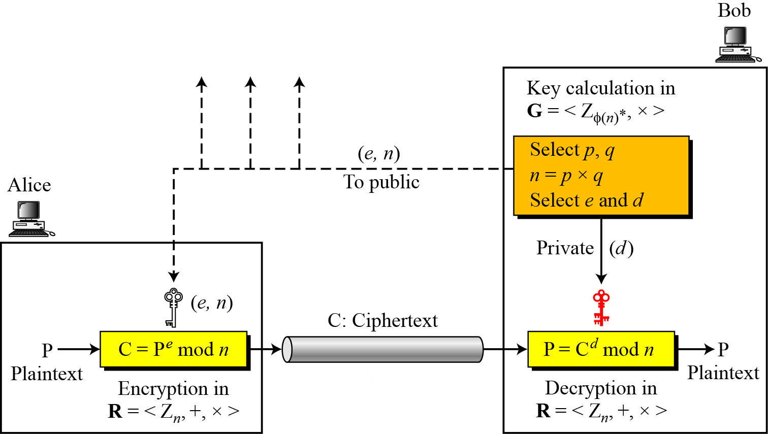
RSA Algorithm: Decryption
  Bob can recover m from c by using his private key exponent d using the following relation:
  m = c^{d} mod n
  After having m, Bob can recover the original message M by reversing the padding scheme.
  The encryption, decryption and key generation in RSA
  is shown in the figure below.
13.9
Figure: Encryption, decryption, and key generation in RSA

Slide 10
RSA Cryptosystem: Trivial Examples
  Example-1:
  Choose p = 3 and q = 11
  Compute n = p * q = 3 * 11 = 33
  Compute φ(n) = φ(p*q) = φ(p)* φ(q)=(p - 1) * (q - 1) = 2 * 10 = 20
  Choose e such that 1 < e < φ(n) and e and φ(n) are coprime. We have several choices for e: 7, 11, 13, 17, 19. (We cannot use 5 as e, because 20 is divisible by 5). Let e = 7
  Compute a value for d such that (d * e) mod φ(n) = 1. One solution is d = 3 [(3 * 7) % 20 = 1] [d is the multiplicative inverse of e]
  Public key is (e, n) => (7, 33)
  Private key is (d, n) => (3, 33)
  The encryption of m = 2 is c = m^{e} mod n = 2⁷ mod 33 = 29
  The decryption of c = 29 is m = c^{d} mod n = 29³ mod 33 = 2
13.10

Slide 11
RSA Cryptosystem: Trivial Examples
Example-2:
Bob chooses 7 and 11 as p and q.
He calculates n = 77. The value of φ(n) = (7 − 1)(11 − 1) or 60.
Now he chooses two exponents, e and d, from Z₆₀∗. If he chooses e to be 13, then d is 37. Note that e × d mod 60 = 1 (they are inverses of each).
Now imagine that Alice wants to send the plaintext 5 to Bob. She uses the public exponent 13 to encrypt 5.
Bob receives the ciphertext 26 and uses the private key 37 to decipher the ciphertext:
13.<number>

Slide 12
RSA Cryptosystem: Trivial Examples
Example-3:
Now assume that another person, John, wants to send a message to Bob.
John can use the same public key announced by Bob (probably on his website), 13.
John’s plaintext is 63. John calculates the following:
Bob receives the ciphertext 28 and uses his private key 37 to decipher the ciphertext:
13.<number>

Slide 13
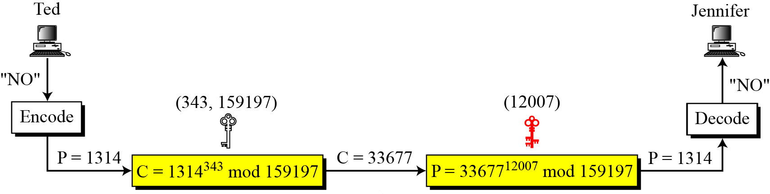
RSA Cryptosystem: Trivial Examples
Example-4:
Jennifer creates a pair of keys for herself. She chooses p = 397 and q = 401.
She calculates n = 159197. She then calculates φ(n) = 158400. She then chooses e = 343 and d = 12007.
Show how Ted can send a message to Jennifer if he knows e and n.
Solution:
Suppose Ted wants to send the message “NO” to Jennifer.
He changes each character to a number (from 00 to 25), with each character coded as two digits.
He then concatenates the two coded characters and gets a four-digit number. The plaintext is 1314.
He then uses e and n to encrypt the message.
Figure below shows the process.
13.<number>

Slide 14
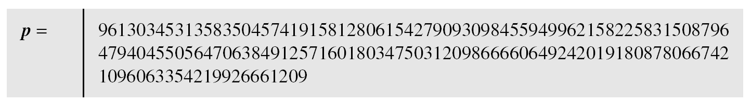
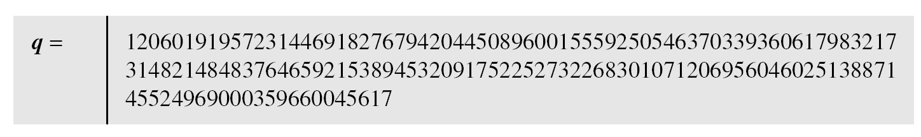
RSA Cryptosystem: Realistic Examples
Example-5:
Here is a more realistic example.
We choose a 512-bit p and q, calculate n and φ(n).
We then choose e and test for relative primeness with φ(n). We then calculate d.
Finally, we show the results of encryption and decryption.
The integer p is a 159-digit number.
13.<number>

Slide 15
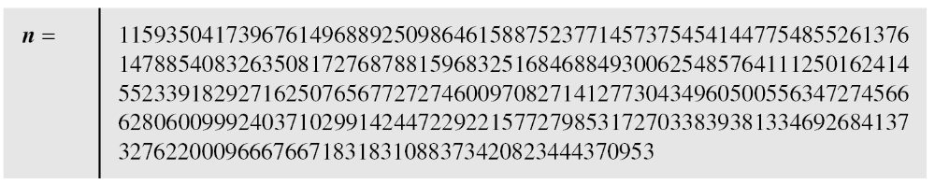
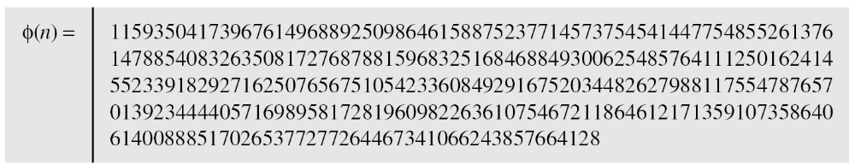
RSA Cryptosystem: Realistic Examples
Example-5 (Continued…):
The modulus n = p × q. It has 309 digits.
φ(n) = (p − 1)(q − 1) has 309 digits.
13.<number>

Slide 16
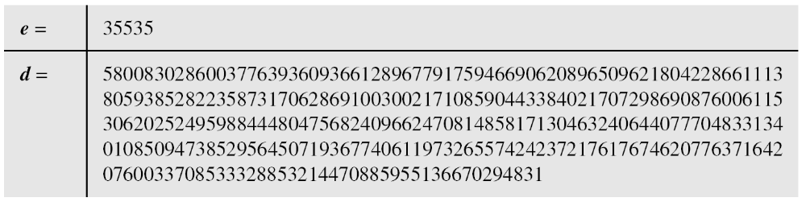
RSA Cryptosystem: Realistic Examples
Example-5 (Continued…):
Bob chooses e = 35535 (the ideal is 65537) and tests it to make sure it is relatively prime with φ(n). He then finds the inverse of e modulo φ(n) and calls it d.
13.<number>

Slide 17
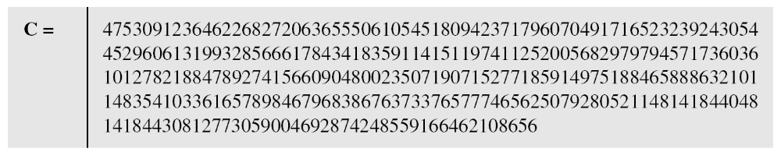
RSA Cryptosystem: Realistic Examples
Example-5 (Continued…):
Alice wants to send the message “THIS IS A TEST”, which can be changed to a numeric value using the 00−26 encoding scheme (26 is the space character).
The ciphertext calculated by Alice is C = P^{e}, which is
13.<number>

Slide 18
RSA Cryptosystem: Realistic Examples
Example-5 (Continued…):
Bob can recover the plaintext from the ciphertext using P = C^{d}, which is
The recovered plaintext is “THIS IS A TEST” after decoding.
13.<number>

Slide 19
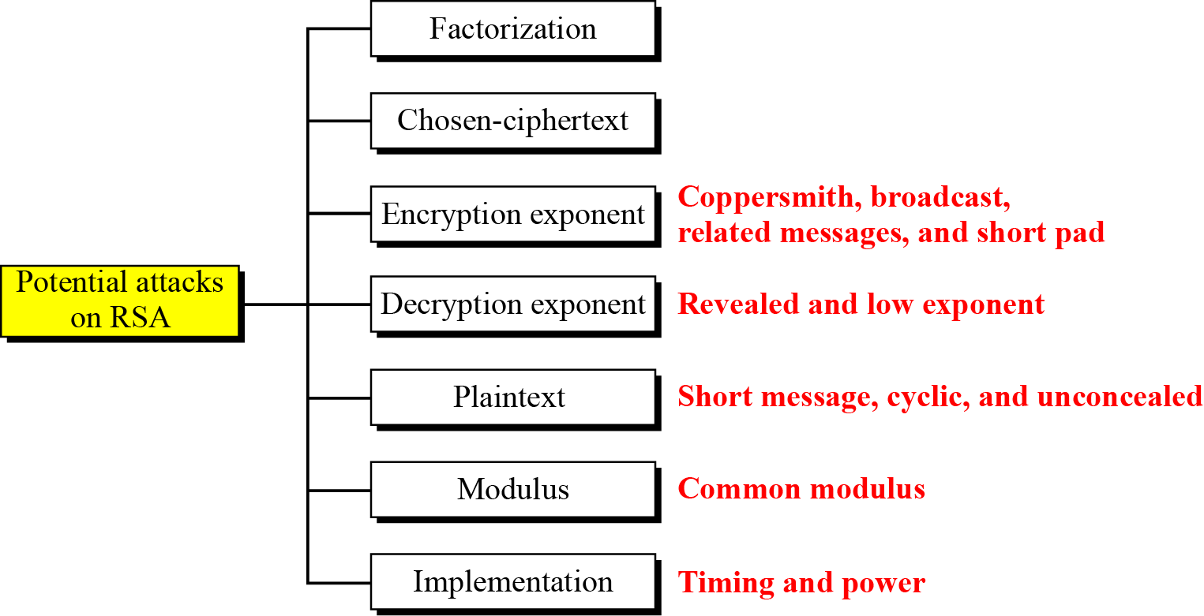
Attacks on RSA Cryptosystem
No devastating attacks on RSA have been yet discovered.
Several attacks have been predicted based on the weak plaintext, weak parameter selection, or inappropriate implementation.
Figure below shows the category of potential attacks on RSA.
13.<number>
Figure: Taxonomy of potential attacks on RSA

Slide 20
  RSA Cryptosystem: Cracking the Code
  The essential requirement of the Public Key Cryptography, like RSA, is that-the public and secret keys are mathematically related, but this relationship must be made very hard to determine by an outsider.
  As we saw in the preceding text, everything starts with p and q, from which we calculated n.
  The public key consists of two numbers: e and n, where e is calculated from φ(n), and φ(n) is calculated from p and q.
  The secret key d, was calculated from e and φ(n) and, as we just stated, e and φ(n) are calculated from p and q.
  It follows then, that d is also calculated from p and q, which proves that the public and private keys are mathematically related.
  So, if an adversary (like Eve) wanted to find the secret key d, by only knowing n, he must break down n into the two prime numbers that were used to produce it (remember that n = p * q).
  Now, here is the real crux of the bisquit: Decomposing a very large n into p and q is really difficult to do. It is easy with the small numbers that we have used in our demonstration, but, for example, if 100 digit numbers are used for p and q, the resulting n will be approximately 200 digits. Then decomposing n into p and q will be very hard. The fastest known factoring algorithm would take far too long for an attacker to ever break the code.
  Well, if you have some free time on your hands, try this challenge: n=13289. Find p and q. If you can find, you may even earn some money.
  Any cryptographic technique which can resist a concerted attack is regarded as secure. At this point in time, the RSA algorithm is considered secure.
13.20

Slide 21
RSA Cryptosystem
  In RSA cryptosystem, encryption using public keys is normally computationally intensive. So, in practice-
  The sender encrypts the message with a secret key that is randomly generated.
  The secret key is encrypted using the public key of the recipient and sent with the encrypted message.
  The recipient decrypts the secret key using his private key and using that secret key, he decrypts the rest of the message.
  The following lists all the steps in the process:
  The client and server go through a handshaking procedure.
  The handshake begins when the client connects to a SSL enabled server requesting a secure connection and presents a list of encryption algorithms and hash functions that it supports.
  From this list the server chooses the most secure encryption algorithm and hash function that it also supports and lets the client know about its choice.
  In the above transaction, the server also sends it identification in the form of a digital certificate. The digital certificate contains the server's name, the trusted Certificate Authority, and the server's public encryption key.
  The client may contact the trusted Certificate Authority for verification.
  The client generates a random number and encrypts it with the server's public key and sends it to the server. Only the server can decrypt this with its private key.
  The random number generated by the client is then used in the encryption and decryption process on both the client and server sides.
13.21

Slide 22
RSA Cryptosystem: Applications
  Although RSA can be used to encrypt and decrypt actual messages, it is very slow if the message is long.
  Therefore, RSA is useful for short messages.
  RSA is used in digital signature and other cryptosystems that often need to encrypt a small message without having access to a symmetric key.
  RSA is also used for authentication.
13.22

Slide 23
Rabin Cryptosystem
  The Rabin cryptosystem (published in January 1979 by Michael O. Rabin) is an asymmetric cryptographic technique, whose security, like that of RSA, is related to the difficulty of factorization.
  This cryptosystem is a variation of the RSA cryptosystem:
  RSA is based on the exponentiation congruence;
  Rabin is based on the quadratic congruence;
  The Rabin cryptosystem can be thought of as an RSA cryptosystem in which the value of e and d are fixed, i.e., e=2 and d=1/2. This means, in Rabin cryptosystem, the formula for encryption is C≡P² mod n and the formula for decryption is P ≡ C^{1/2} mod n.
  The public key in the Rabin cryptosystem is n and the private key is (p,q). Everyone can encrypt a message using n; only Bob can decrypt the message using p and q.
  Decryption of the message is infeasible for Eve because she does not know the values of p and q.
13.23

Slide 24
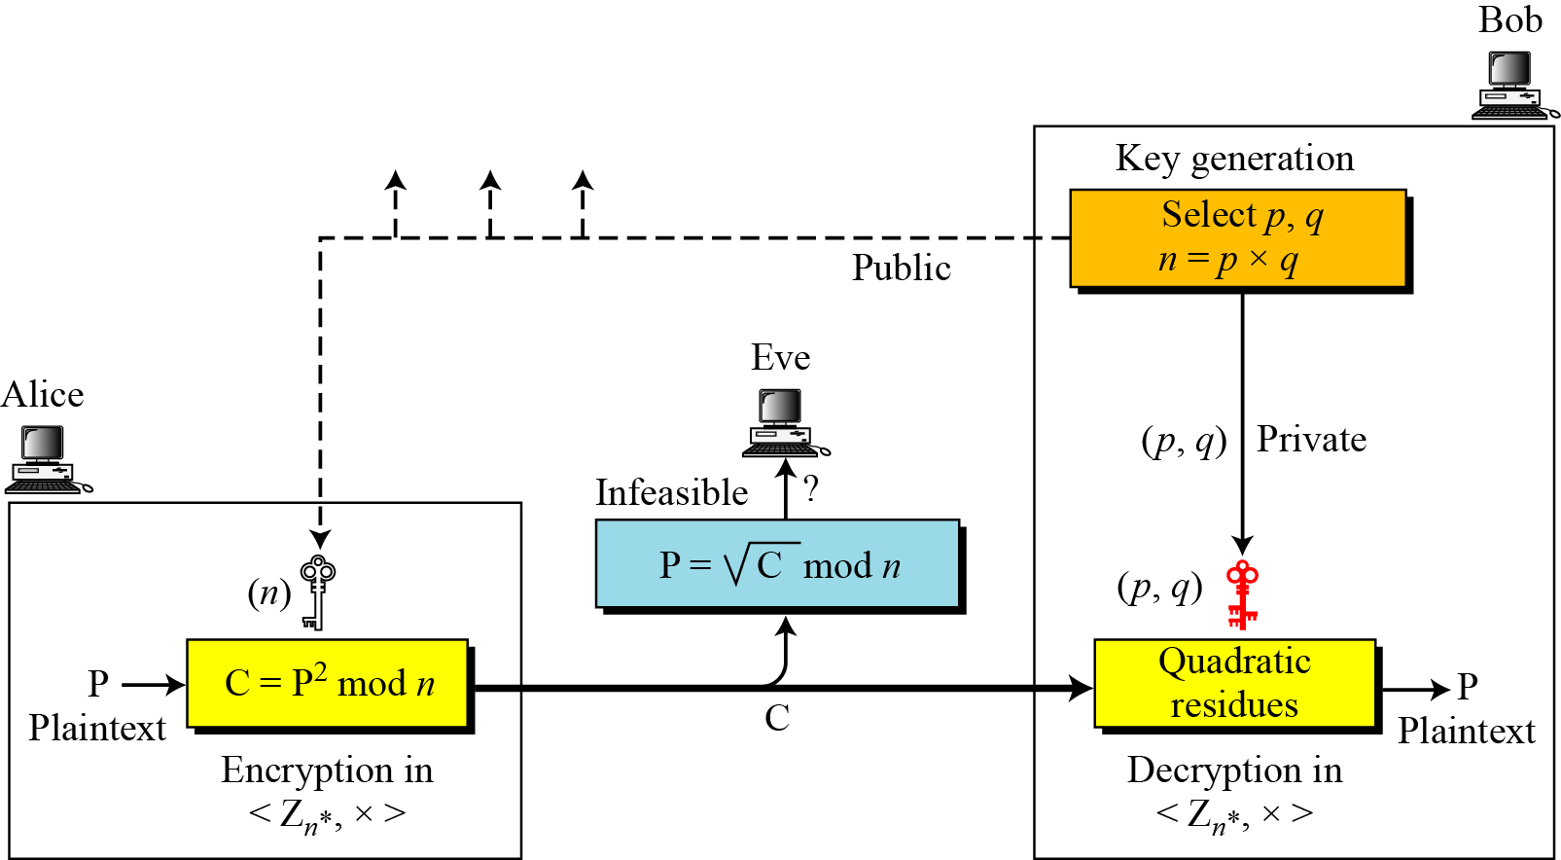
Rabin Cryptosystem
  In Rabin cryptosystem, Bob chooses two large and distinct prime numbers p and q such that p ≡ q ≡ 3 (mod4) and then he calculates n=p x q. He announces n as the public key and keeps (p, q) to him as the private key.
  Anyone (say Alice) can encrypt a message using the public key based on the formula: C≡P² mod n and can send the encrypted message to Bob.
  Using the private key, Bob alone can decrypt the message.
  The process is shown in the figure below.
13,24
Figure: Rabin cryptosystem

Slide 25
Rabin Algorithm: Key Generation
  As with all asymmetric cryptosystems, the Rabin system uses both a public and a private key.
  The public key is necessary for encryption and can be published.
  The private key must be possessed only by the recipient of the message.
  The precise key-generation process for Rabin cryptosystem is as follows:
  Choose two large distinct primes p and q.
  One may choose p and q such that p ≡ q ≡ 3 (mod4) to simplify the computation of square roots modulo p and q. But the scheme works with any primes.
  Compute n = p * q. Then n is the public key. The primes p and q are the private key.
  To encrypt a message, only the public key n is needed.
  To decrypt a ciphertext, the factors p and q of n are necessary.
  As a trivial example, if p = 7 and q = 11, then n=77. The public key 77 would be released, and the message is encoded using this key. In order to decode the message, the private keys 7 and 11 would have to be known.
13.25

Slide 26
Rabin Algorithm: Encryption
  Anyone can send a message to Bob using his public key n.
  The encryption process is listed below:
  Represent the message as an integer in the range {0,……, n-1}.
  Now the ciphertext c is determined by
  c = m² mod n
  That is, c is the quadratic remainder of the square of the plaintext, modulo the key-number n.
  Note:
  In Rabin cryptosystem, encryption is very simple. The operation needs only one multiplication, which can be done quickly. This is beneficial when resources are limited. For example, smart cards have limited memory and need to use short CPU time.
  As a trivial example, let p = 7 and q = 11, then n=77 is the public key which will be used to encrypt the message.
  In our simple example, P = { 0, 2, …., 76} is our plaintext space. We will take m = 20 as our plaintext. The ciphertext is thus c = m² mod n = 20² mod 77 = 400 mod 77= 15.
  For exactly four different values of m, the ciphertext 15 is produced, i.e. for m in { 13, 20, 57, 64 }. This is true for most ciphertexts produced by the Rabin algorithm, i.e. it is a four-to-one function.
13.26

Slide 27
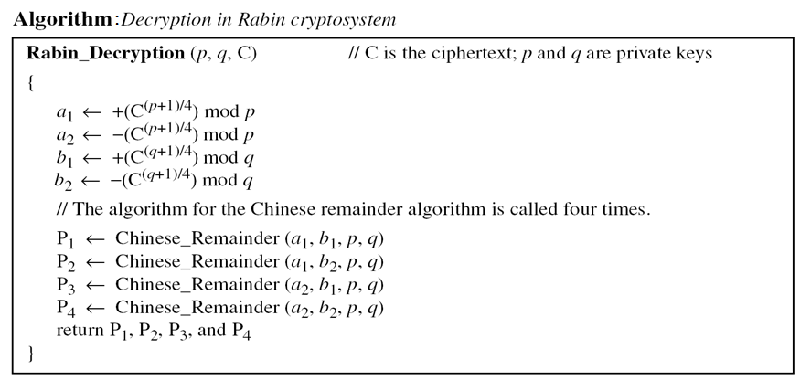
Rabin Algorithm: Decryption
  To decrypt the ciphertext, the private keys are necessary.
  Decryption is based on the solution of quadratic congruence.
  Because the received ciphertext is the square of the plaintext, it is guaranteed that C has roots (quadratic residues) in Z_{n}*. The Chinese remainder algorithm is used to find four square roots.
  Rabin cryptosystem is not deterministic: decrypting a message can produce four different plaintext outputs, of which only one is the correct plaintext. It is up to the receiver of the message to choose one of these four as final answer.
  The decryption is performed by the following algorithm:
13.<number>

Slide 28
Rabin Algorithm: Trivial Example
Here is a very trivial example to show the idea.
Bob selects p = 23 and q = 7. Note that both are congruent to 3 mod 4.
Bob calculates n = p × q = 161.
Bob announces n publicly; he keeps p and q private.
Alice wants to send the plaintext P = 24. Note that 161 and 24 are relatively prime; 24 is in Z₁₆₁*. She calculates C = 24² = 93 mod 161, and sends the ciphertext 93 to Bob.
Bob receives 93 and calculates four values:
a₁ = +(93 ^{(23+1)/4}) mod 23 = 1 mod 23
a₂ = −(93 ^{(23+1)/4}) mod 23 = 22 mod 23
b₁ = +(93 ^{(7+1)/4}) mod 7 = 4 mod 7
b₂ = −(93 ^{(7+1)/4}) mod 7 = 3 mod 7
Bob takes four possible answers, (a₁, b₁), (a₁, b₂), (a₂, b₁), and (a₂, b₂), and uses the Chinese remainder theorem to find four possible plaintexts: 116, 24, 137, and 45. Note that only the second answer is Alice’s plaintext.
13.<number>

Slide 29
Evaluation of Rabin Algorithm
  Effectiveness:
  In Rabin cryptosystem, decoding produces three false results in addition to the correct one, so that the correct result must be guessed. This is the major disadvantage of the Rabin cryptosystem and one of the factors which have prevented it from finding widespread practical use.
  If the plaintext is intended to represent a text message, guessing is not difficult; however, if the plaintext is intended to represent a numerical value, this issue becomes a problem that must be resolved by some kind of disambiguation scheme. It is possible to choose plaintexts with special structures, or to add padding, to eliminate this problem.
  A way of removing the ambiguity of inversion was suggested by Blum and Williams:
  the two primes used are restricted to primes congruent to 3 modulo 4 and the domain of the squaring is restricted to the set of quadratic residues. These restrictions make the squaring function into a trapdoor permutation, eliminating the ambiguity.
13.29

Slide 30
Evaluation of Rabin Algorithm
  Security:
  The Rabin cryptosystem is computationally secure against a chosen plaintext attack provided that the modulus n can not be factored. That is, if p and q are very large, then Rabin system is as secure as RSA.
  The great advantage of the Rabin cryptosystem is that a random plaintext can be recovered entirely from the ciphertext only if the codebreaker is capable of efficiently factoring the public key n. Note that this is a very weak level of security. Extensions of the Rabin cryptosystem achieve stronger notions of security.
  It has been proven that decoding the Rabin cryptosystem is equivalent to the integer factorization problem, which is rather different than for RSA. Thus the Rabin system is 'more secure' in this sense than is RSA, and will remain so until a general solution for the factorization problem is discovered, or until the RSA problem is discovered to be equivalent to factorization. (This assumes that the plaintext was not created with a specific structure to ease decoding.)
13.30

Slide 31
RSA Vs. Rabin Cryptosystems
  Both the RSA and the Rabin cryptosystems are asymmetric cryptographic techniques.
  Rabin cryptosystem is a variation of the RSA cryptosystem:
  RSA is based on the exponentiation congruence;
  Rabin is based on the quadratic congruence;
  The Rabin cryptosystem can be thought of as an RSA cryptosystem in which the value of e and d are fixed, i.e., e=2 and d=1/2. This means, in Rabin cryptosystem, the formula for encryption is C≡P² mod n and the formula for decryption is P ≡ C^{1/2} mod n.
  The public key in the Rabin cryptosystem is n and the private key is (p,q). But in RSA, the public key is (e,n) and private key is d.
  If Bob is using RSA, he can keep d and n; and discard vp, q, and φ(n) after key generation. But, if Bob is using Rabin cryptosystem, he needs to keep p and q.
13.31

Slide 32
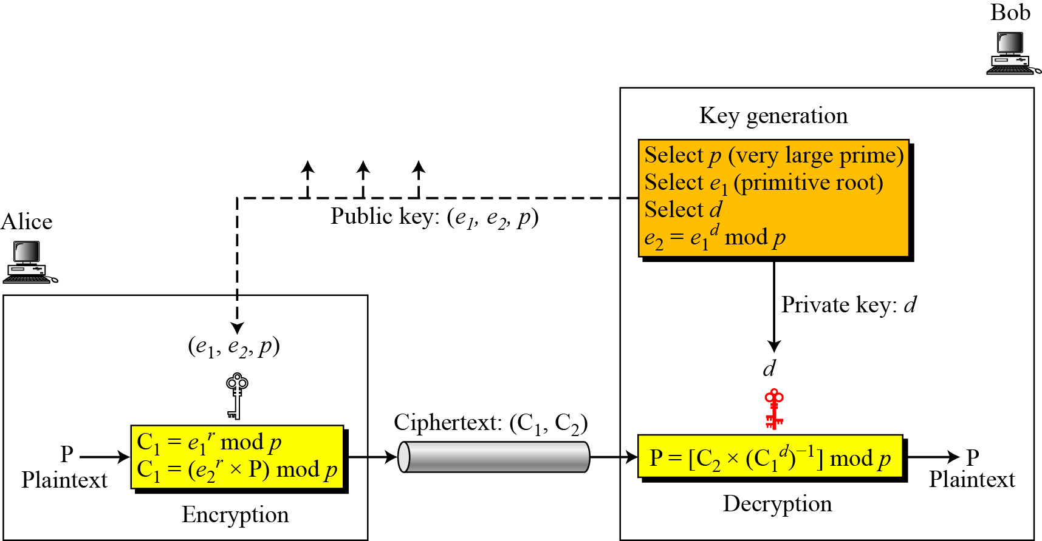
ElGamal Cryptosystems
  Besides RSA and Rabin, another public-key cryptosystem is ElGamal, named after its inventor Taher ElGamal.
  This cryptosystem is based on the discrete logarithm problem.
  Figure below shows the key generation, encryption, and decryption in ElGamal cryptosystem.
13.32
Figure: Key generation, encryption, and decryption in ElGamal

Slide 33
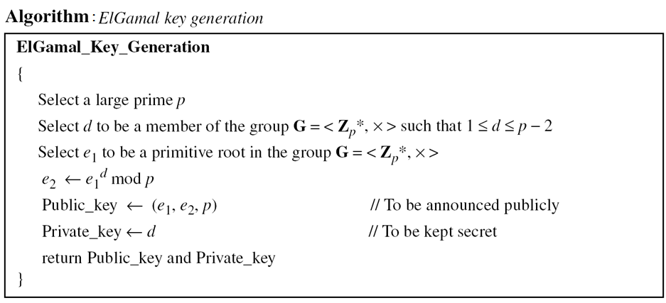
ElGamal Cryptosystems: Key Generation
  Bob uses the steps shown in the algorithm below to create his public and private keys.
13.<number>

Slide 34
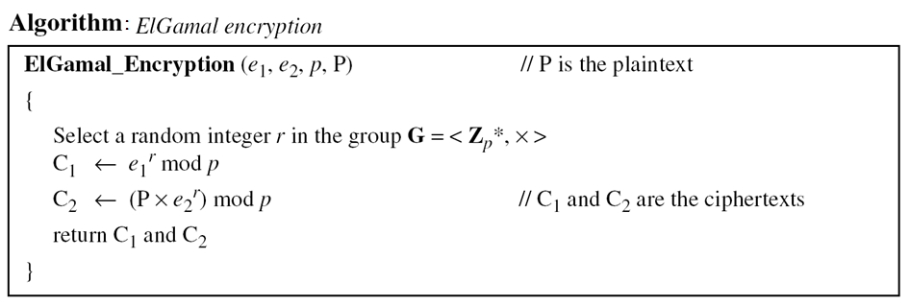
ElGamal Cryptosystems: Encryption
  Anyone can send a message to Bob using his public key.
  The encryption process is shown in the algorithm below.
13.<number>

Slide 35
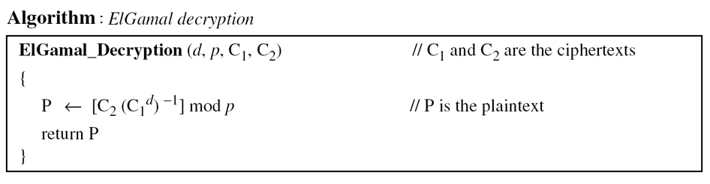
ElGamal Cryptosystems: Decryption
  Bob can use the following algorithm to decrypt the ciphertext message he received.
13.<number>

Slide 36
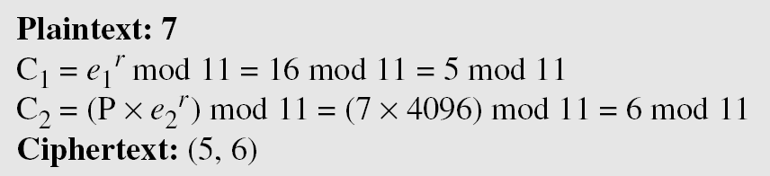
ElGamal Cryptosystems: Trivial Example
Here is a trivial example.
Bob chooses p = 11 and e₁ = 2. Note that 2 is a primitive root in Z₁₁*.
Bob then chooses d = 3 and calculate e₂ = e₁^{d} = 8.
So the public keys are (2, 8, 11) and the private key is 3.
Alice chooses r = 4 and calculates C₁ and C₂ for the plaintext 7.
Bob receives the ciphertexts (5 and 6) and calculates the plaintext.
13.<number>

Slide 37
ElGamal Cryptosystems: Trivial Example
Instead of using P = [C₂ × (C₁^{d}) ⁻¹] mod p for decryption, we can avoid the calculation of multiplicative inverse and use
P = [C₂ × C₁ ^{p−1−d}] mod p.
In the previous example, we can calculate
P = [6 × 5 ¹¹⁻¹⁻³] mod 11= 7 mod 11.
For the ElGamal cryptosystem, p must be at least 300 digits and r must be new for each encipherment.
13.<number>

Slide 38
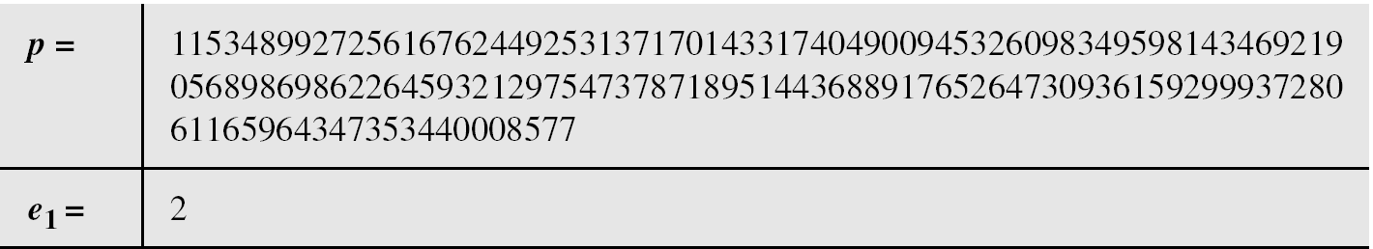
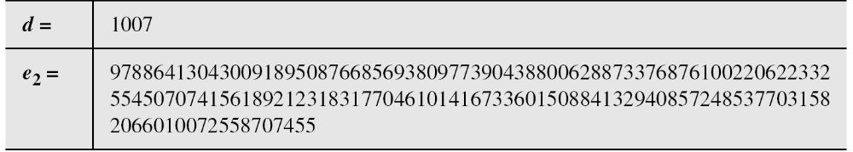
ElGamal Cryptosystems: Realistic Example
Bob uses a random integer of 512 bits (the ideal is 1024 bits).
The integer p is a 155-digit number (the ideal is 300 digits).
Bob then chooses e₁, d, and calculates e₂, as shown below:
Bob announces (e₁, e₂, p) as his public key and keeps d as his private key.
13.<number>

Slide 39
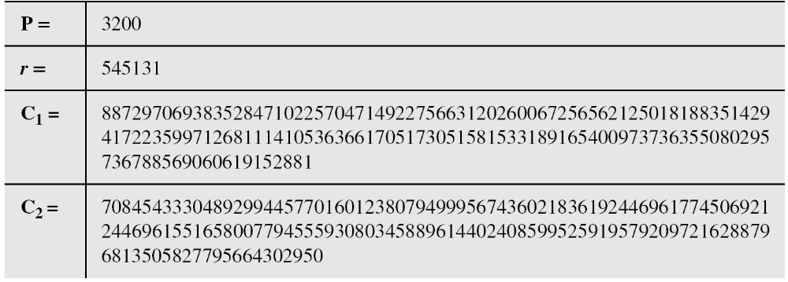
ElGamal Cryptosystems: Trivial Example
Alice has the plaintext P = 3200 to send to Bob.
She chooses r = 545131, calculates C₁ and C₂, and sends them to Bob.
Bob calculates the plaintext P = C₂ × ((C₁)^{d})⁻¹ mod p = 3200 mod p.
13.<number>

Slide 40
ElGamal Cryptosystems: Application
ElGamal can be used whenever RSA can be used.
It is used for key exchange, authentication, and encryption and decryption of small messages.
13.<number>

